Slide 1
INTRODUCTION TO MACHINE LEARNING
INTRODUCTION
Andreu Arderiu
NORTHIN SUMMER SCHOOL
Barcelona, July 2022

Slide 2
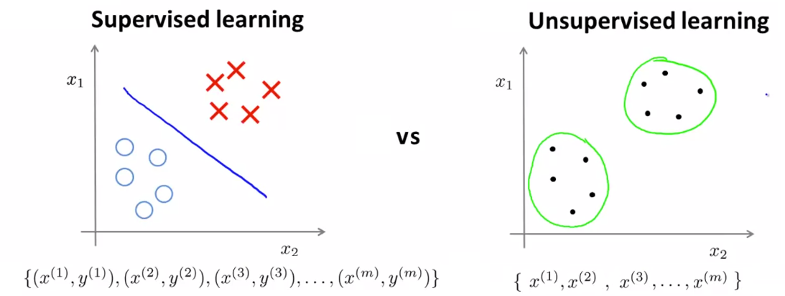

Unsupervised learning: overview
Unsupervised: Only inputs $X$ are given. We compute $f$ such that $y=f(X)$ is a “simpler” representation
Clustering: discrete $y$ (groups)
Dimensionality reduction: continuous $y$
Source: coursera

Slide 3
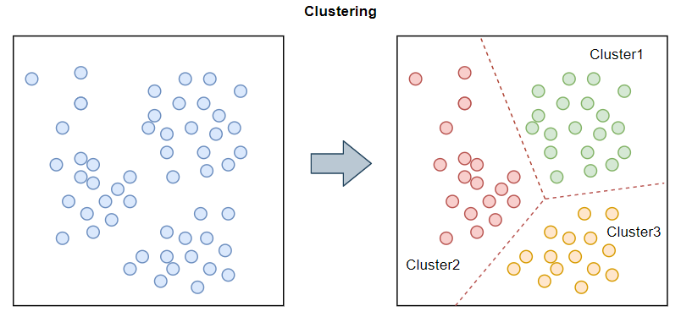
Clustering :overview
Given a set of points and a notion of distance between points, group them into a number of clusters so that
members of the same cluster are close
members of different clusters are far from each other
Source: ecloud valley

Slide 4
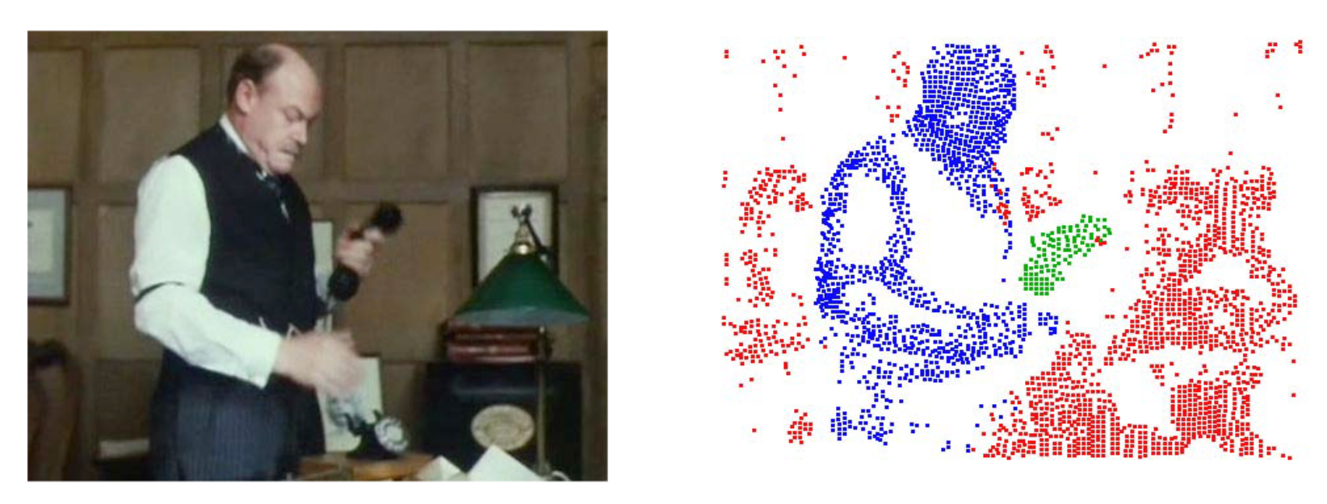
Clustering: use cases
Data exploration
Image or data segmentation
…
Source: Brox and Mali, ECCV 2012

Slide 5
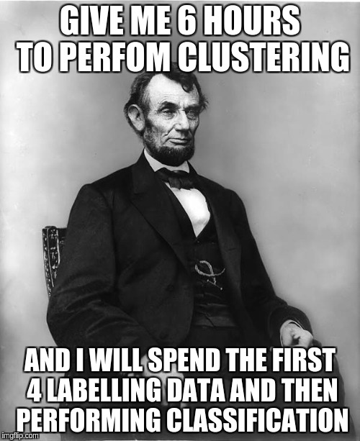
Clustering: a hard problem!
Clustering in 2D and small amounts of data looks easy, but….
Usually data have lots of features, high-dimensional spaces!
Curse of dimensionality: In very high dimensions, almost all pair of points are about at the same distance
Source: Imgflip

Slide 6
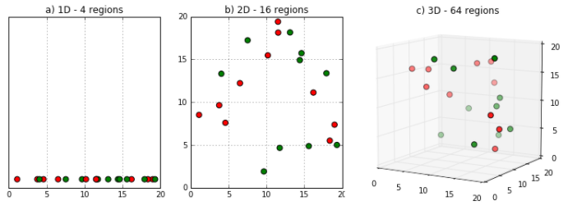
Curse of dimensionality
As dimensionality grows, there are fewer observations per region.
- 1d: 4 regions, 2d: 4² regions, 1000d: hopeless
Source: Prasanth Damodharan

Slide 7
Clustering: K-means algorithm
Goal: assign each data point to one of k clusters so that the total distance of points to their centroids is minimized
K-means algorithm:
Randomly initialise K cluster centroids
Assign points to their closest centroid
For each cluster recompute its centroid (mean coordinates of points of the cluster)
Iterate 2-3 until convergence
Usually Euclidean distance, but other alternatives can be also used

Slide 8
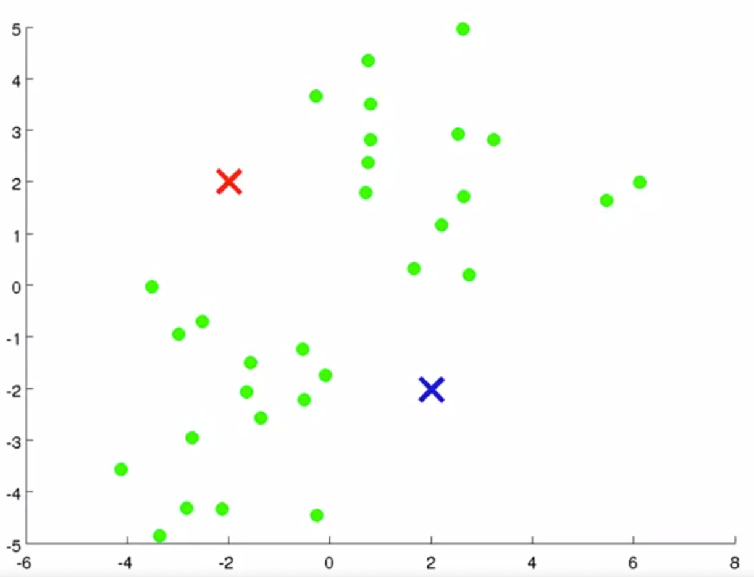
K-means algorithm example (k=2)
Initialize cluster centroids
Credit: Guillaume Dehaene, EPFL

Slide 9
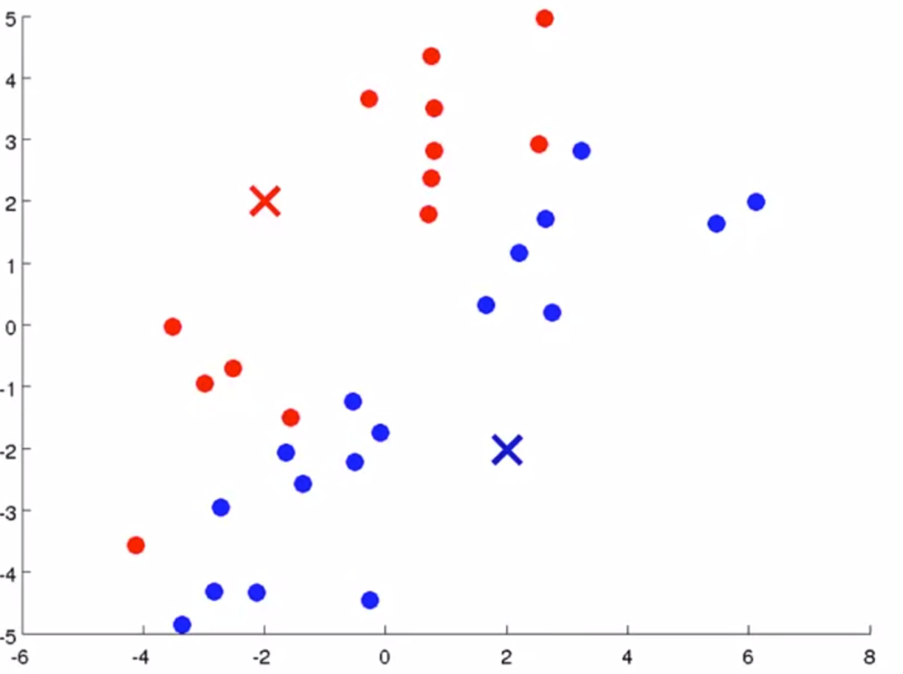
K-means algorithm example (k=2)
Assign points to cluster
Credit: Guillaume Dehaene, EPFL

Slide 10
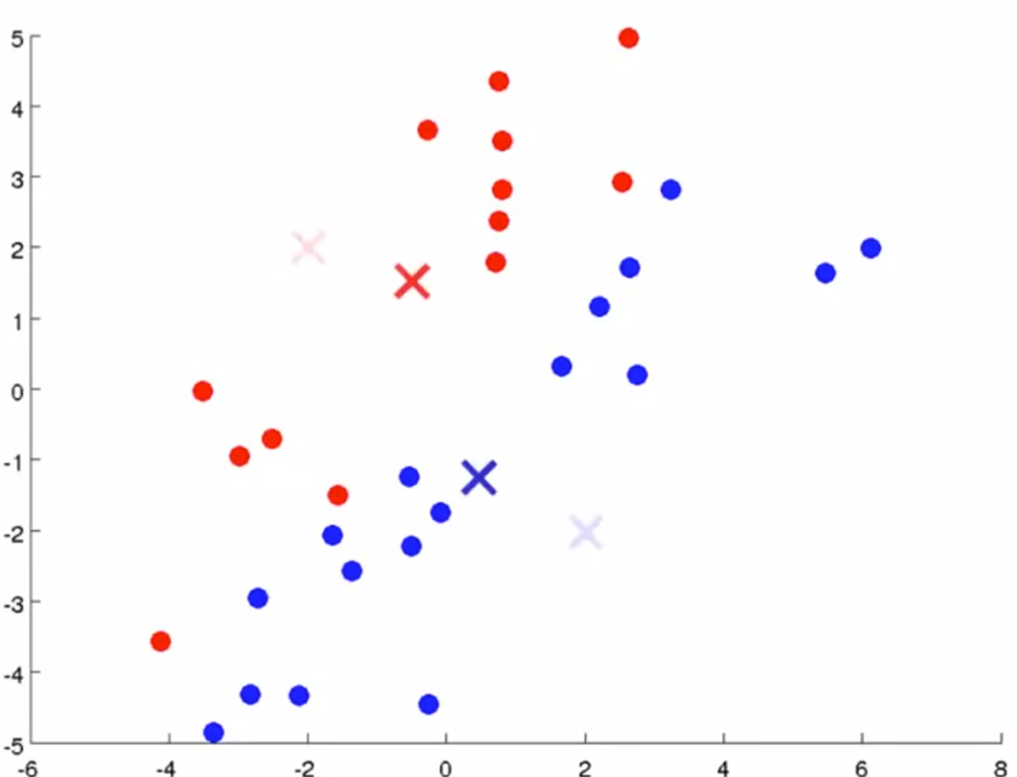
K-means algorithm example (k=2)
Update centroids
Credit: Guillaume Dehaene, EPFL

Slide 11
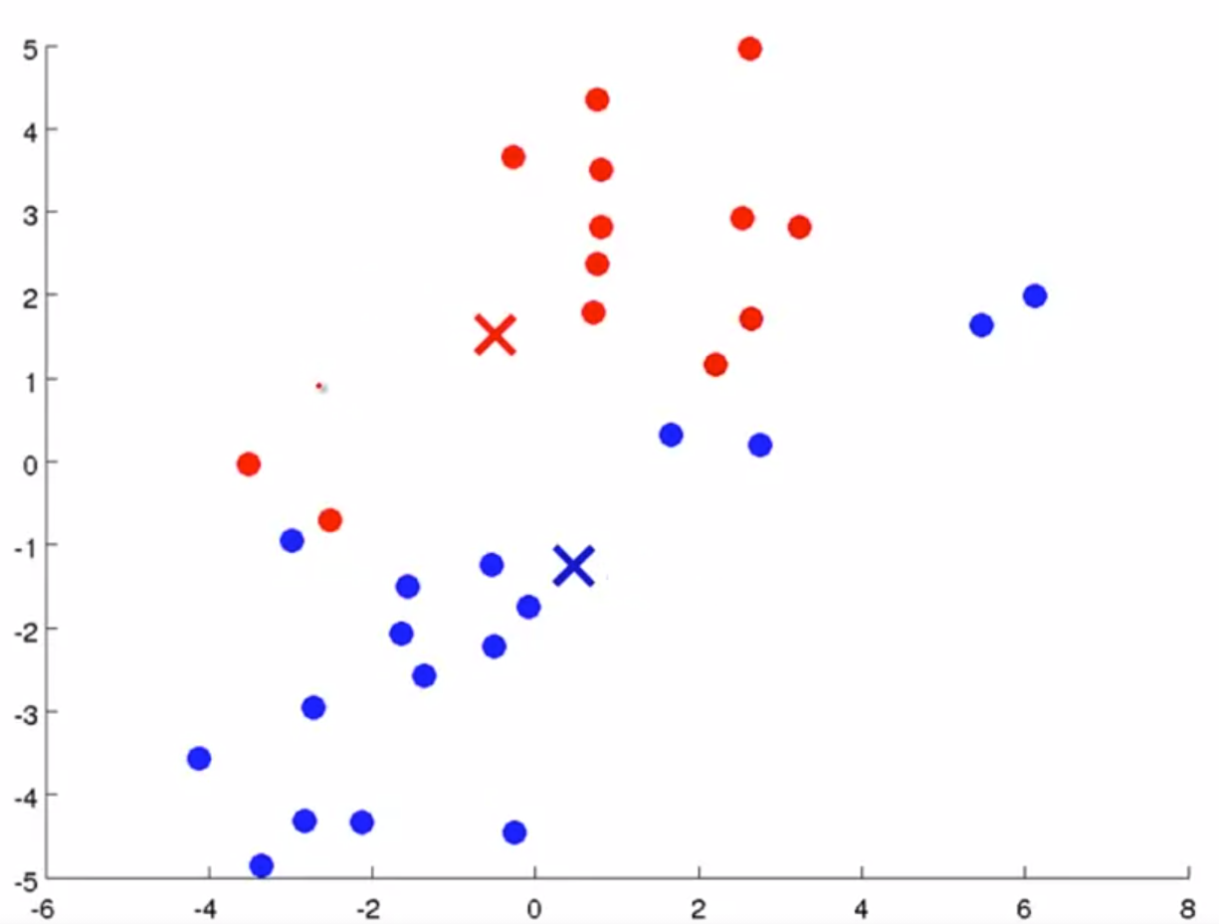
K-means algorithm example (k=2)
Assign points to cluster
Credit: Guillaume Dehaene, EPFL

Slide 12
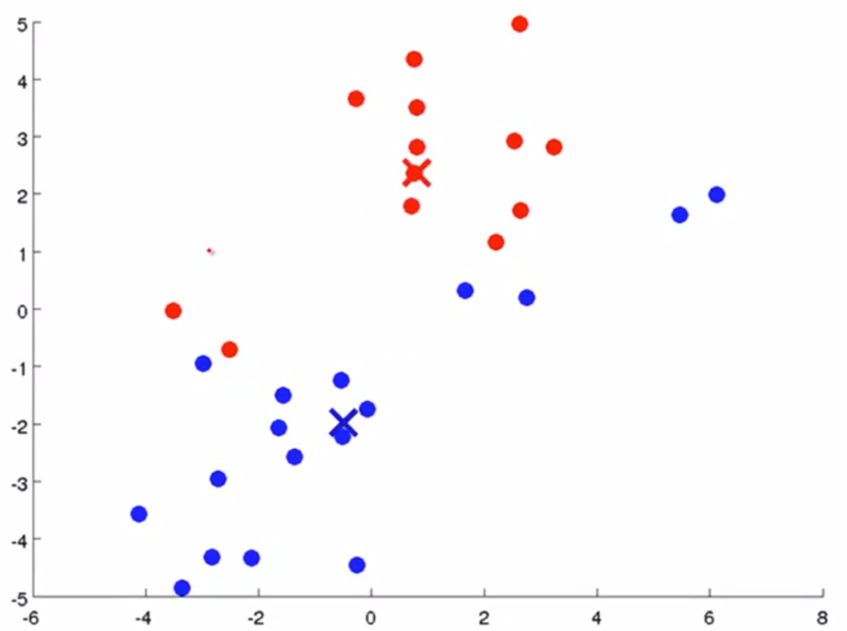
K-means algorithm example (k=2)
Update centroids
Credit: Guillaume Dehaene, EPFL

Slide 13
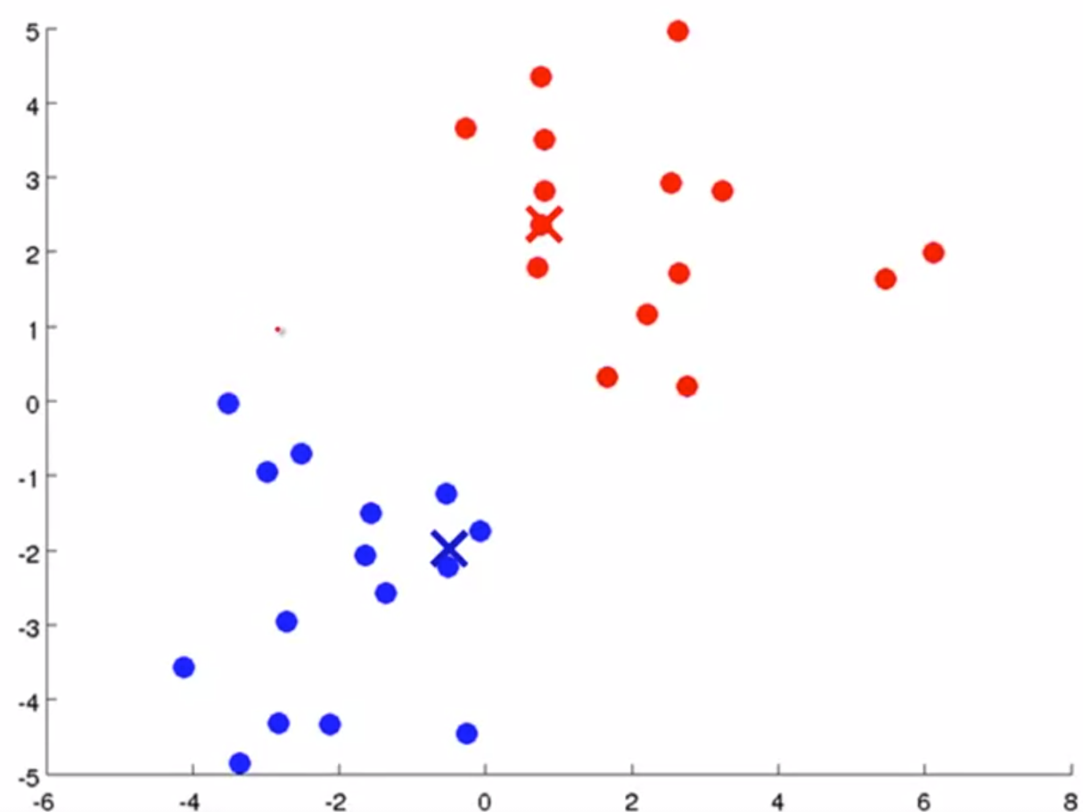
K-means algorithm example (k=2)
Assign points to cluster
Credit: Guillaume Dehaene, EPFL

Slide 14
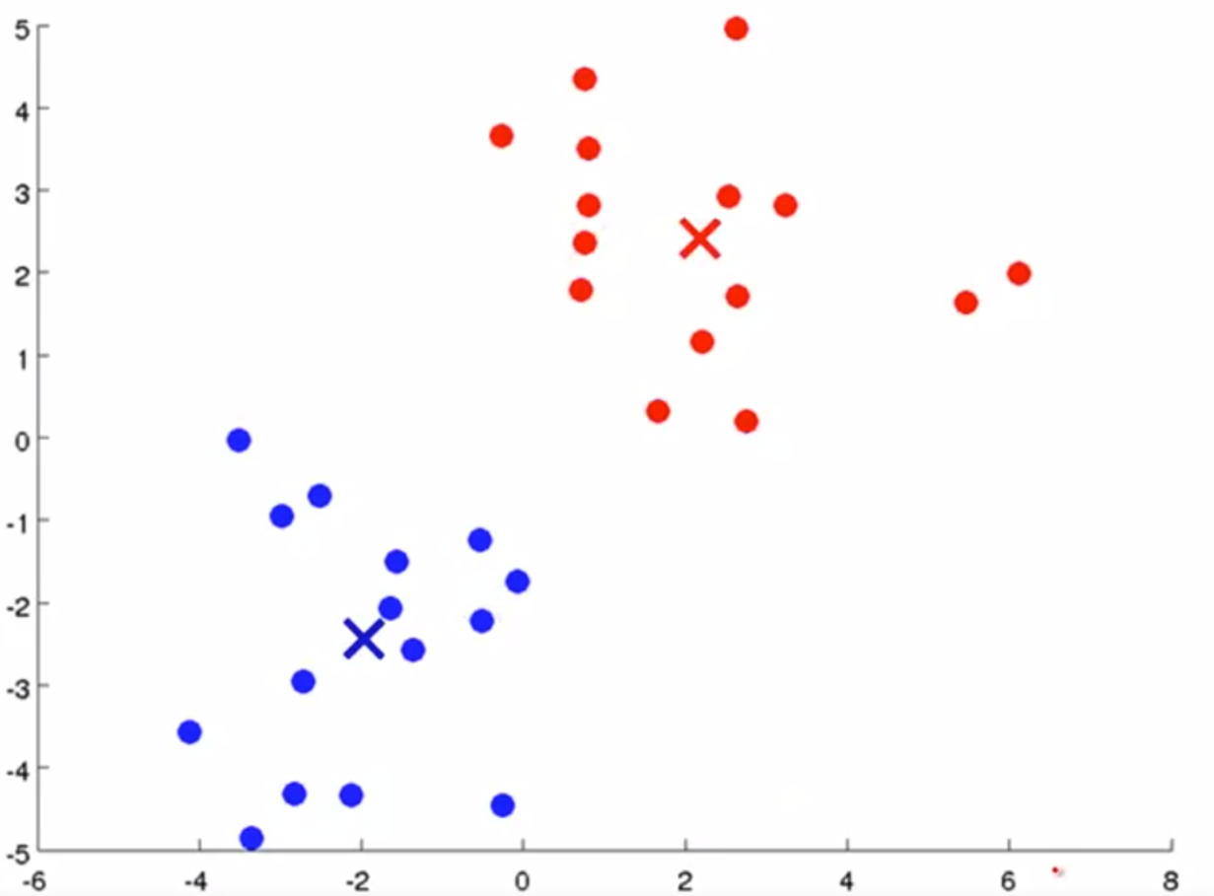
K-means algorithm example (k=2)
Update centroids
Done!
Credit: Guillaume Dehaene, EPFL

Slide 15
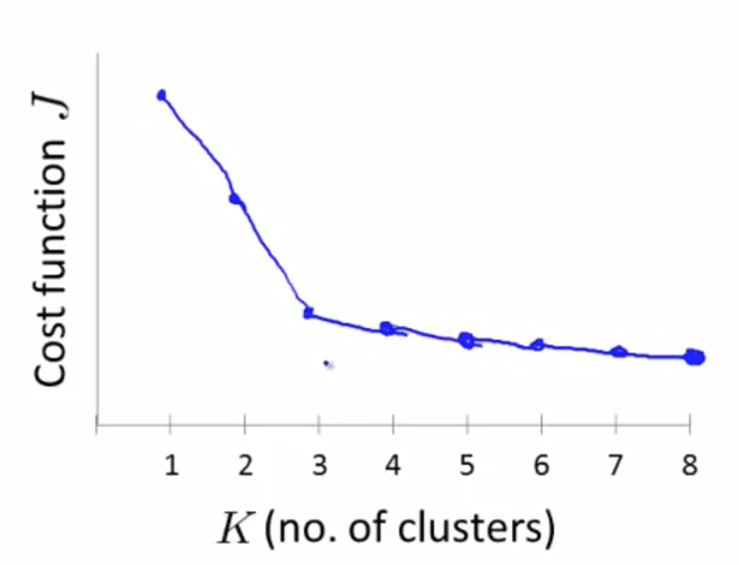

K-means: choosing k
Elbow method: run k-means with different values of k and compute certain cost function J (usually “silhouette”)
QUIZZ: Which k should we choose ?
Source: Coursera

Slide 16
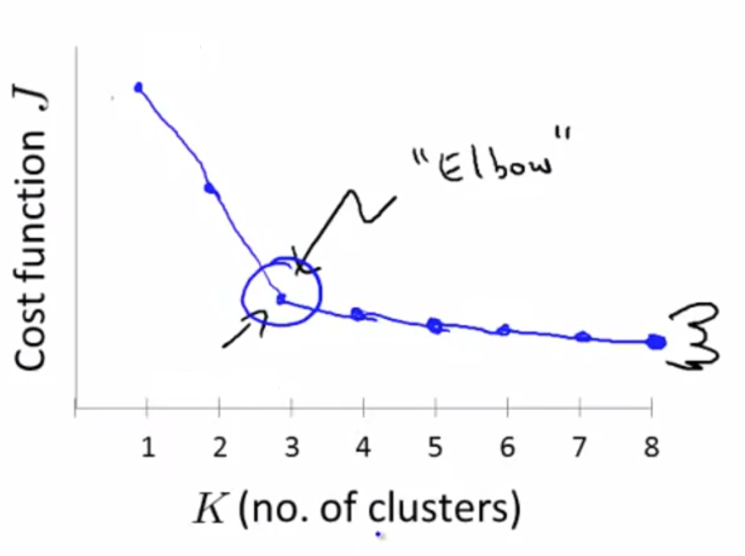
K-means: choosing k
Elbow method: run k-means with different values of k and compute certain cost function J (usually “silhouette”)
QUIZZ: Which k should we choose ?
Source: Coursera
K = 3

Slide 17
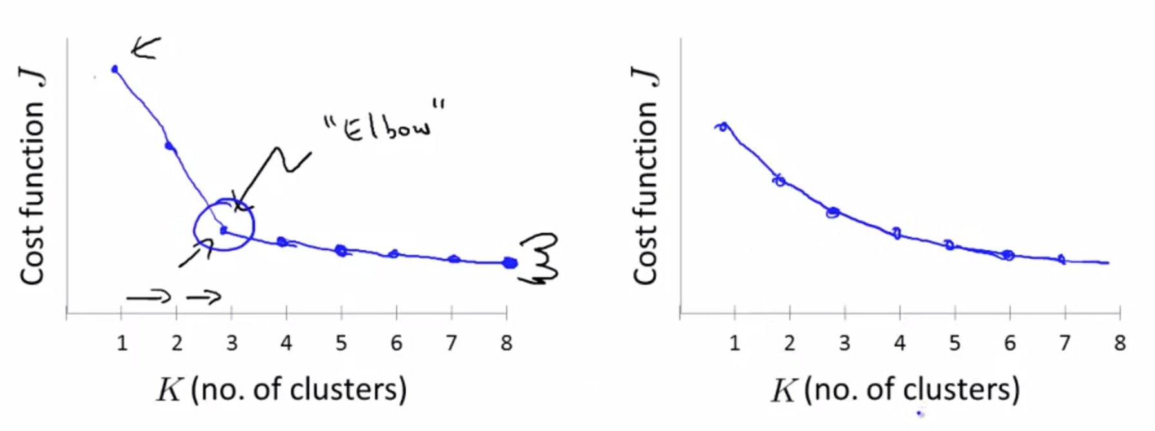
K-means: choosing k issues
Usually “elbow” is not visible, and the choice of k is somewhat arbitrary
Source: Coursera

Slide 18


K-means: pros and cons
Pros:
Simple and easy to interpret
Efficient and scales well with large datasets
Convergence is guaranteed
Cons:
Choice of k is not trivial
It is sensitive to centroid initialisation
Not robust to outliers
Poor performance in very high dimensions
Poor performance with “complex” shape data

Slide 19
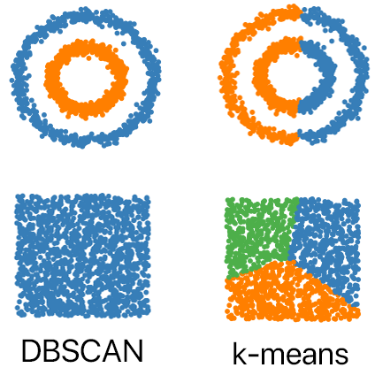
Clustering alternative: DBSCAN
“Density-based spatial clustering of applications with noise”
Does not require k choice
Good performance with “complex” shapes
Density-based clustering, follows the
shape of dense neighbourhoods of points
Slower than k-means, but no need to
choose k a priori

Slide 20
Dimensionality reduction: overview
Two main motivations:
Data compression: Save computer memory and speed up learning algorithms
Visualization: Plots in 2D, 3D are human-interpretable

Slide 21
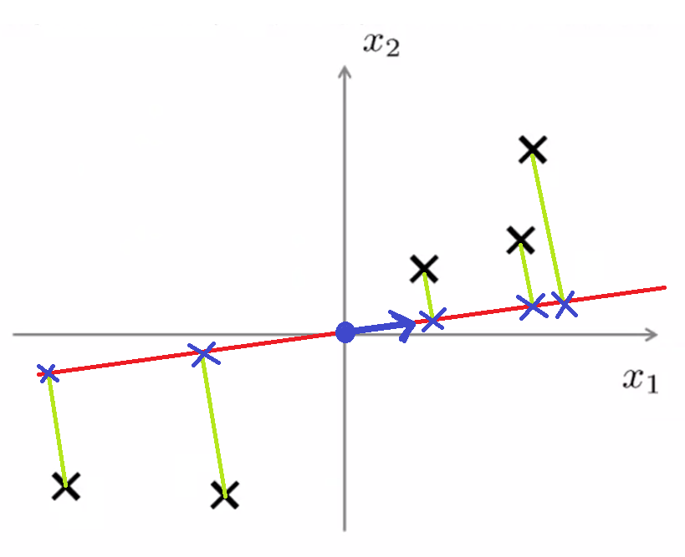
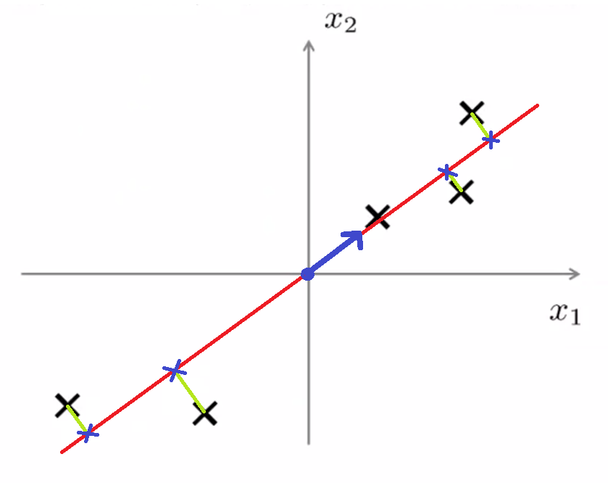


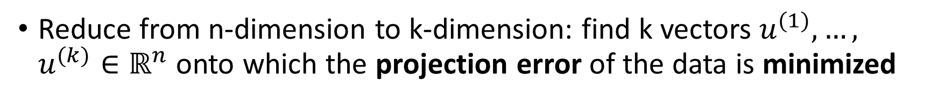
PCA: intuition
Reduce from n-dimension to k-dimension: find k vectors $u^{(1)},…,$ $u^{(k)}∈ℝ^{n}$onto which the projection error of the data is minimized
Reduce projection error
projection error
$$u^{(1)}$$
$$u^{(1)}$$

Slide 22
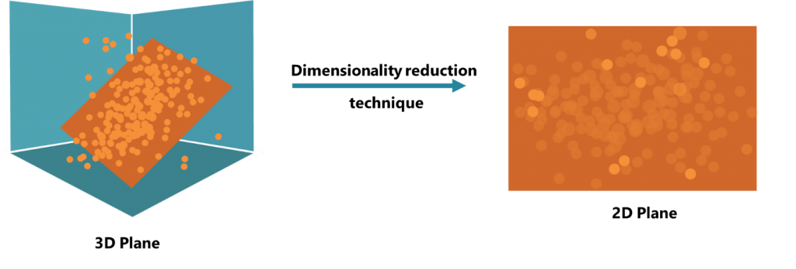
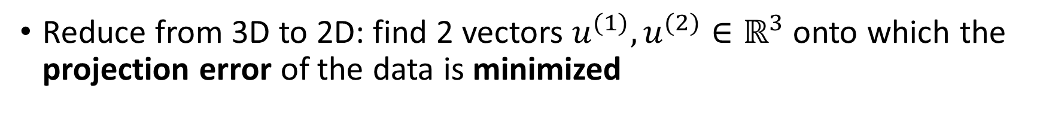
PCA: intuition
Reduce from 3D to 2D: find 2 vectors $u^{(1)},u^{(2)}∈ℝ^{3}$onto which the projection error of the data is minimized

Slide 23
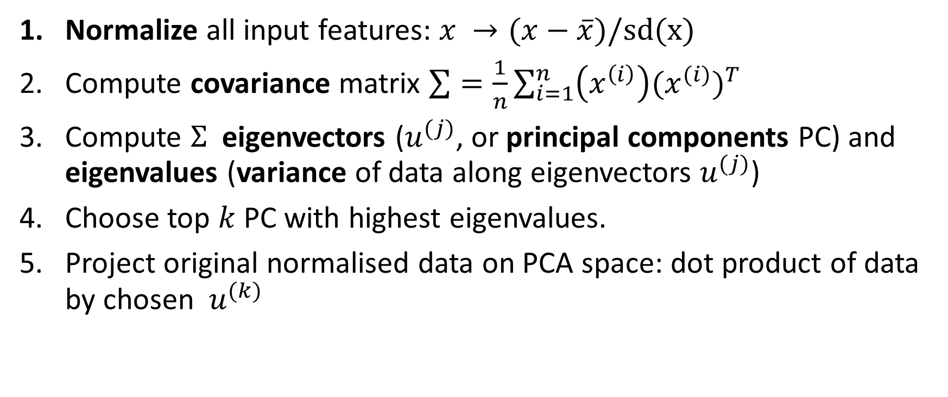
PCA: algorithm summary
Normalize all input features: $x →(x−\overline{x})/sd(x)$
Compute covariance matrix $\sum{=\frac{1}{n}}\sum_{i=1}^{n}{\left(x^{\left(i\right)}\right){{(x}^{(i)})}^{T}}$
Compute $Σ$ eigenvectors ($u^{(j)}$, or principal components PC) and eigenvalues (variance of data along eigenvectors $u^{(j)}$)
Choose top $k$PC with highest eigenvalues.
Project original normalised data on PCA space: dot product of data by chosen $u^{(k)}$

Slide 24
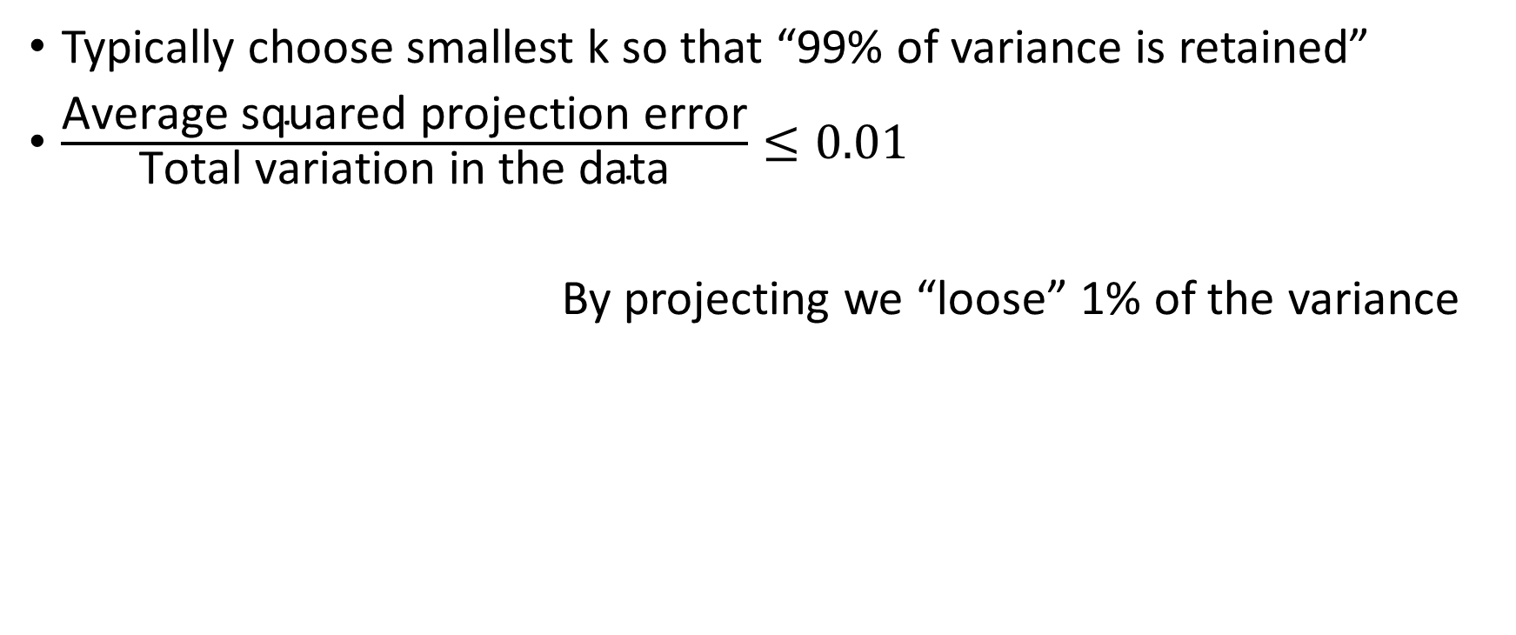
PCA: choice of dimension (k)
Typically choose smallest k so that “99% of variance is retained”
$\frac{\text{Average} \text{squared} \text{projection} \text{error}}{\text{Total} \text{variation} \text{in} \text{the} \text{data}}≤0.01$
By projecting we “loose” 1% of the variance

Slide 25
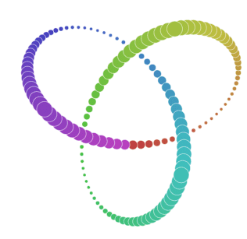
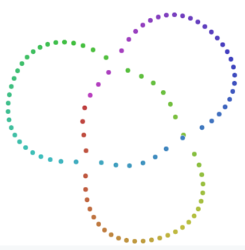
Alternative for visualization: t-SNE
t-distributed Stochastic Neighbour Embedding
While PCA preserves global structure of the data, t-SNE preserves only local similarities
Non-linear method, very flexible preserves local structures that with other methods (as PCA) might be lost
t-SNE
Source: Wattenberg et al., 2016

